Slide 1
Operating Systems Course
Hamid R. Zarandi
h_zarandi@aut.ac.ir

Slide 2
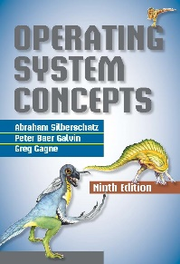
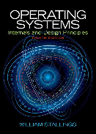
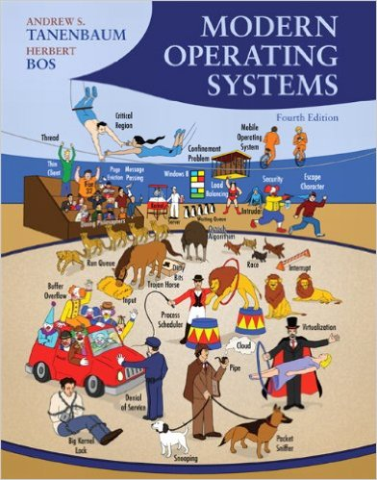
Textbooks
Silberschatz et. al. Operating System Concepts
9th Edition, Wiley, 2013.
Stallings, Operating Systems: Internal and Design Principles
9th Edition, Pearson, 2015.
Tanenbaum, Modern Operating Systems
4th Edition, Prentice-Hall, 2014.

Slide 3
Course highlights & grading
Grading details
Mid-term (6)
Final (9)
Homeworks (2)
Project(s) (2)
Presence (1)
TA
Fatemeh Ghezloo
Ismail Naderi
Highlights
What Operating Systems Do
Computer-System Organization
Computer-System Architecture
Operating-System Structure
Operating-System Operations
Process Management
Memory Management
Storage Management
Protection and Security
Kernel Data Structures
Computing Environments
Open-Source Operating Systems

Slide 4
OS topics

Slide 5
Introductions to Operating Systems

Slide 6
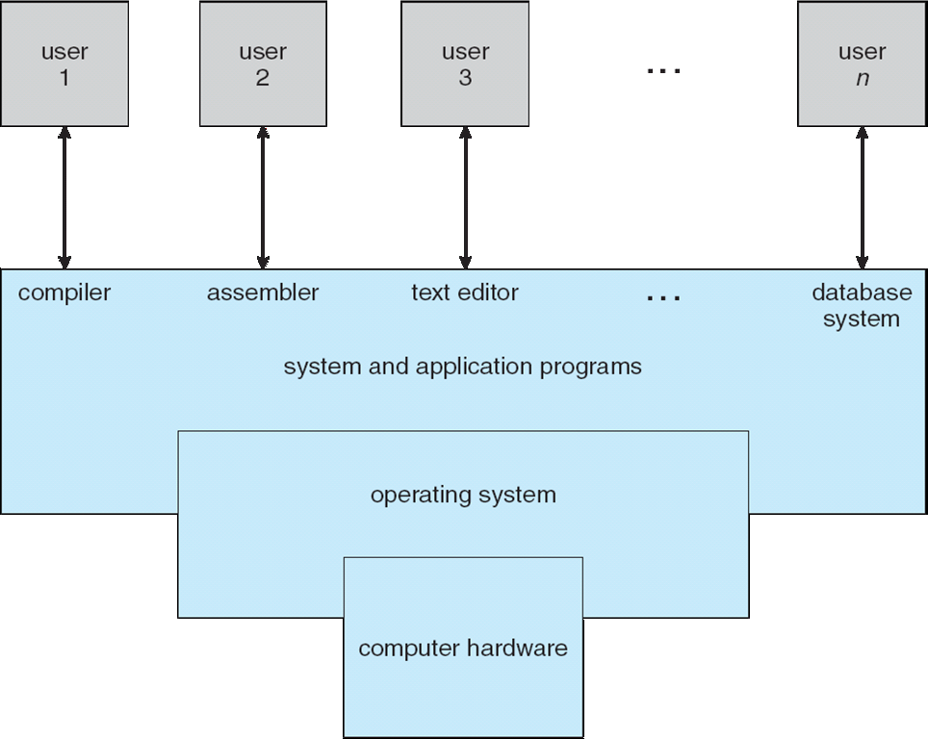
What is an Operating System?
A program that acts as an intermediary between a user of a computer and the computer hardware
User can execute programs convenient & efficient

Slide 7
What operating systems do?
Users want convenience, ease of use and good performance
Don’t care about resource utilization
But shared computer such as mainframe or minicomputer must keep all users happy
Users of dedicate systems such as workstations have dedicated resources but frequently use shared resources from servers
Handheld computers are resource poor, optimized for usability and battery life
Some computers have little or no user interface, such as embedded computers in devices and automobiles

Slide 8


Operating system definition
OS is a resource allocator
Manages all resources
Decides between conflicting requests for efficient and fair resource use
OS is a control program
Controls execution of programs to prevent errors and improper use of the computer

Slide 9
No uniform definition!
No universally accepted definition!
“The one program running at all times on the computer” is the kernel.

Slide 10
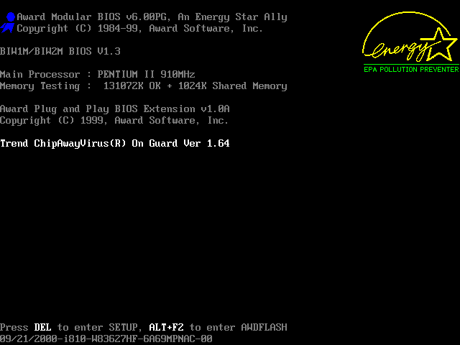
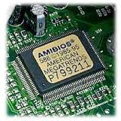
Computer startup
Bootstrap program is loaded at power-up or reboot
Typically stored in ROM or EPROM, generally known as firmware
Initializes all aspects of system
Loads operating system kernel and starts execution

Slide 11
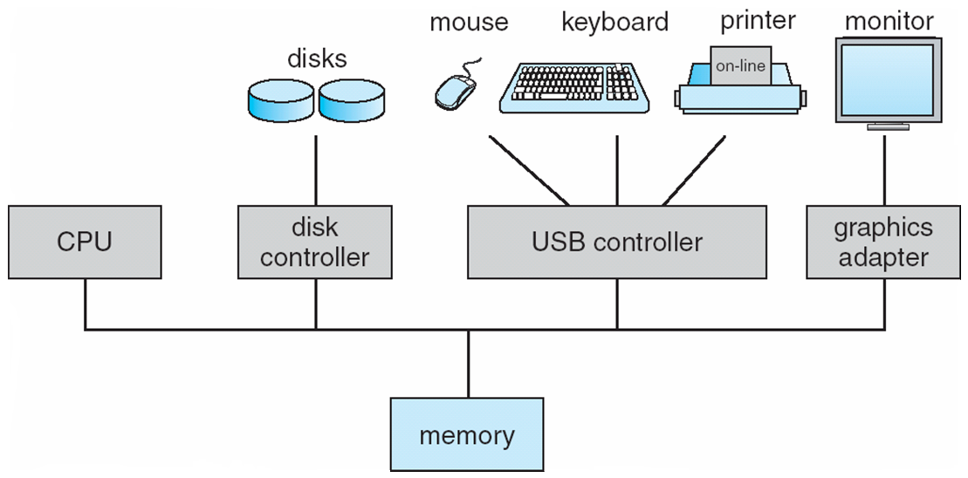
Computer system organization
Computer-system operation
One or more CPUs, device controllers connect through common bus providing access to shared memory
Concurrent execution of CPUs and devices competing for memory cycles

Slide 12
Computer system, basic elements

Slide 13
Computer-system operation
I/O devices and the CPU can execute concurrently
Each device controller is in charge of a particular device type
Each device controller has a local buffer
CPU moves data from/to main memory to/from local buffers
I/O is from the device to local buffer of controller
Device controller informs CPU that it has finished its operation by causing an interrupt

Slide 14
OS is interrupt driven!

Slide 15
Interrupts

Slide 16
Control flow (w/wo interrupts)
waiting
OS

Slide 17
Handling interrupts

Slide 18
Interrupt handling
PIC sends the interrupt address

Slide 19
Multiple interrupts
Disabling interrupt can be done to prevent future ones.

Slide 20
Common functions of interrupts
Interrupt transfers control to the interrupt service routine generally, through the interrupt vector, which contains the addresses of all the service routines
Interrupt architecture must save the address of the interrupted instruction
A trap or exception is a software-generated interrupt caused either by an error or a user request
An operating system is interrupt driven

Slide 21
Interrupt handling
The operating system preserves the state of the CPU by storing registers and the program counter
Determines which type of interrupt has occurred:
polling
vectored interrupt system
Separate segments of code determine what action should be taken for each type of interrupt

Slide 22
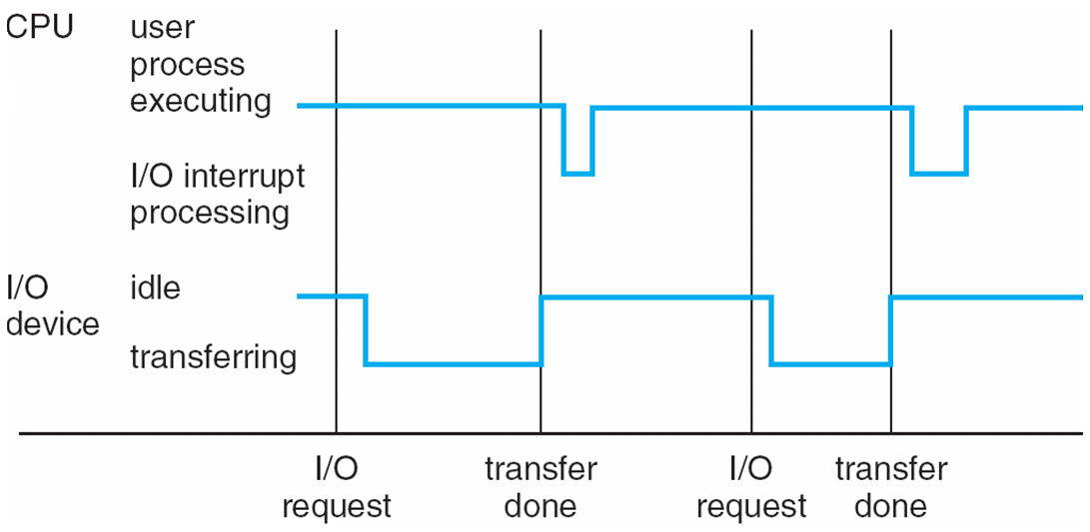
Interrupt timeline

Slide 23
Storage Definitions and Notation Review

Slide 24
Storage definitions and notation review
The basic unit of computer storage is the bit. A bit can contain one of two values, 0 and 1. All other storage in a computer is based on collections of bits. Given enough bits, it is amazing how many things a computer can represent: numbers, letters, images, movies, sounds, documents, and programs, to name a few. A byte is 8 bits, and on most computers it is the smallest convenient chunk of storage. For example, most computers don’t have an instruction to move a bit but do have one to move a byte. A less common term is word, which is a given computer architecture’s native unit of data. A word is made up of one or more bytes. For example, a computer that has 64-bit registers and 64-bit memory addressing typically has 64-bit (8-byte) words. A computer executes many operations in its native word size rather than a byte at a time.
Computer storage, along with most computer throughput, is generally measured and manipulated in bytes and collections of bytes.
A kilobyte, or KB, is 1,024 bytes
a megabyte, or MB, is 1,024² bytes
a gigabyte, or GB, is 1,024³ bytes
a terabyte, or TB, is 1,024⁴ bytes
a petabyte, or PB, is 1,024⁵ bytes
Computer manufacturers often round off these numbers and say that a megabyte is 1 million bytes and a gigabyte is 1 billion bytes. Networking measurements are an exception to this general rule; they are given in bits (because networks move data a bit at a time).

Slide 25
Storage structure
Main memory – only large storage media that the CPU can access directly
Random access
Typically volatile
Secondary storage – extension of main memory that provides large nonvolatile storage capacity
Hard disks – rigid metal or glass platters covered with magnetic recording material
Disk surface is logically divided into tracks, which are subdivided into sectors
The disk controller determines the logical interaction between the device and the computer
Solid-state disks – faster than hard disks, nonvolatile
Various technologies
Becoming more popular

Slide 26
Storage hierarchy
Storage systems organized in hierarchy
Speed
Cost
Volatility
Caching – copying information into faster storage system; main memory can be viewed as a cache for secondary storage
Device Driver for each device controller to manage I/O
Provides uniform interface between controller and kernel

Slide 27
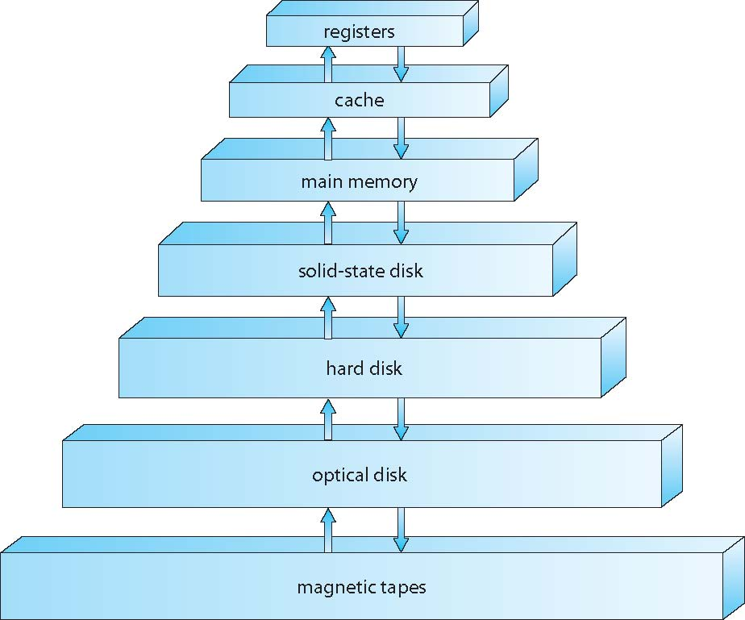
Storage-device hierarchy

Slide 28
Performance of various levels of storage
Movement between levels of storage hierarchy can be explicit or implicit

Slide 29
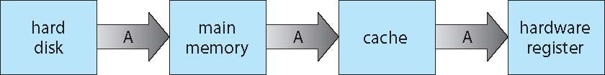
Migration of data “A” from disk to register
Multitasking environments must be careful to use most recent value, no matter where it is stored in the storage hierarchy
Multiprocessor environment must provide cache coherency in hardware such that all CPUs have the most recent value in their cache
Distributed environment situation even more complex
Several copies of a datum can exist
Various solutions covered in Chapter 17

Slide 30
Cache memory

Slide 31
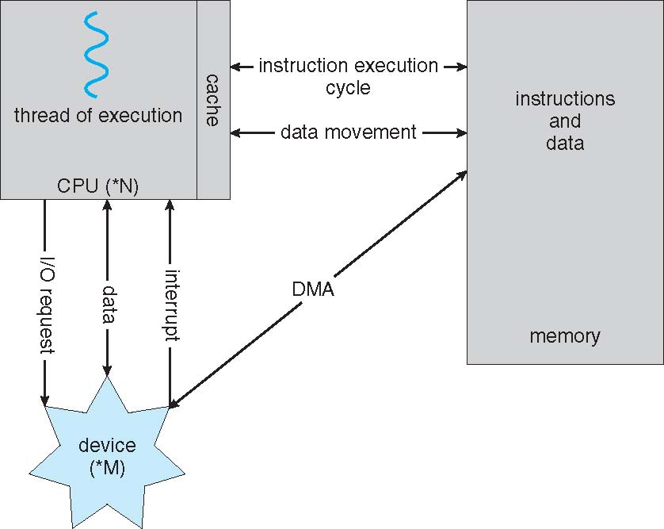
DMA: direct memory access
IO operations
Programmed IO (polling)
Interrupt-driven
DMA
Whether a read or write is requested
The address of the I/O device
The starting location in memory to read data/write data
The number of words

Slide 32
Computer System Architecture

Slide 33
Computer-system architecture
Most systems use a single general-purpose processor
Most systems have special-purpose processors as well
Multiprocessors systems growing in use and importance
Also known as parallel systems, tightly-coupled systems
Advantages include:
Increased throughput
Economy of scale – multiprocessors vs. multiple single processor
Increased reliability – graceful degradation or fault tolerance
Two types:
Asymmetric Multiprocessing – each processor is assigned a specie task (boss-worker).
Symmetric Multiprocessing – each processor performs all tasks

Slide 34
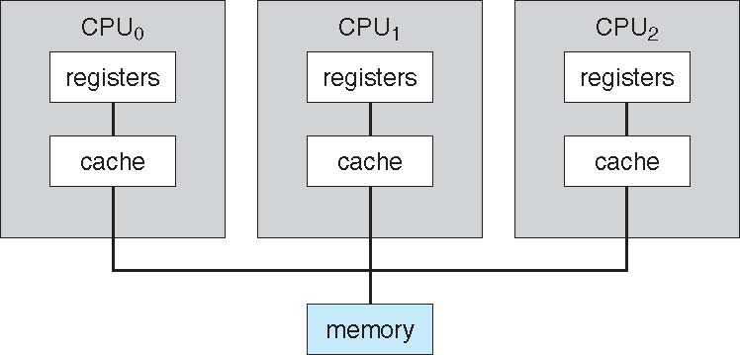
Symmetric multiprocessing architecture
Multiprocessors memory access divisions:
UMA (uniform memory access)
NUMA (non-uniform memory access)

Slide 35
Symmetric multiprocessing organization

Slide 36
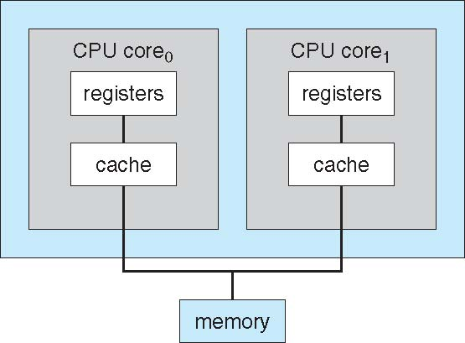
A dual-core design
Multi-chip and multicore
Systems containing all chips
Chassis containing multiple separate systems
Advantage:
Faster communications
Less power consumption
Disadvantage:
Performance gap of CPU utilization by software

Slide 37
Intel core i7-990X block diagram

Slide 38
Blade servers
Multiple processor boards, I/O boards, and networking boards are placed in the same chassis.
Each blade-processor
boots independently
runs its own OS!

Slide 39
Clustered systems
Like multiprocessor systems, but multiple systems working together (loosely-coupled systems)
Usually sharing storage via a storage-area network (SAN)
Provides a high-availability service which survives failures
Asymmetric clustering has one machine in hot-standby mode
Symmetric clustering has multiple nodes running applications, monitoring each other
Some clusters are for high-performance computing (HPC)
Applications must be written to use parallelization
Some have distributed lock manager (DLM) to avoid conflicting operations

Slide 40
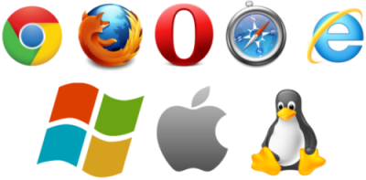
Operating System Structure

Slide 41
Operating system structure
Multiprogramming (Batch system) needed for efficiency
Single user cannot keep CPU and I/O devices busy at all times
Multiprogramming organizes jobs (code and data) so CPU always has one to execute
A subset of total jobs in system is kept in memory
One job selected and run via job scheduling
When it has to wait (for I/O for example), OS switches to another job
Timesharing (multitasking) is logical extension in which CPU switches jobs so frequently that users can interact with each job while it is running, creating interactive computing
Response time should be < 1 second
Each user has at least one program executing in memory process
If several jobs ready to run at the same time  CPU scheduling
If processes don’t fit in memory, swapping moves them in and out to run
Virtual memory allows execution of processes not completely in memory

Slide 42
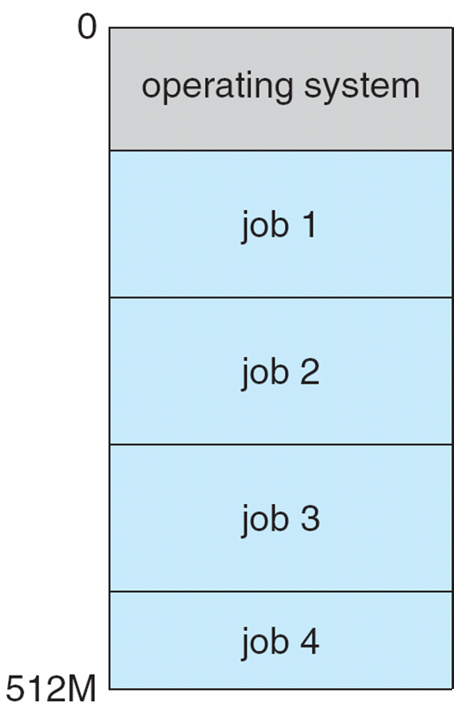
Memory layout for multiprogrammed system
Job pool on a disk!
Physical memory
Virtual memory

Slide 43
System utilization example

Slide 44
Increasing system utilization example
OS idle state is done by HLT assembly instruction (x86 opcode 0xF4)

Slide 45
Operating-system operations
Interrupt driven (hardware and software)
Hardware interrupt by one of the devices
Software interrupt (exception or trap):
Software error (e.g., division by zero)
Request for operating system service
Other process problems include infinite loop, processes modifying each other or the operating system

Slide 46
Operating-system operations (cont.)
Dual-mode operation allows OS to protect itself and other system components
User mode and kernel mode
Mode bit provided by hardware
Provides ability to distinguish when system is running user code or kernel code
Some instructions designated as privileged, only executable in kernel mode
System call changes mode to kernel, return from call resets it to user
Increasingly CPUs support multi-mode operations
i.e. virtual machine manager (VMM) mode for guest VMs

Slide 47
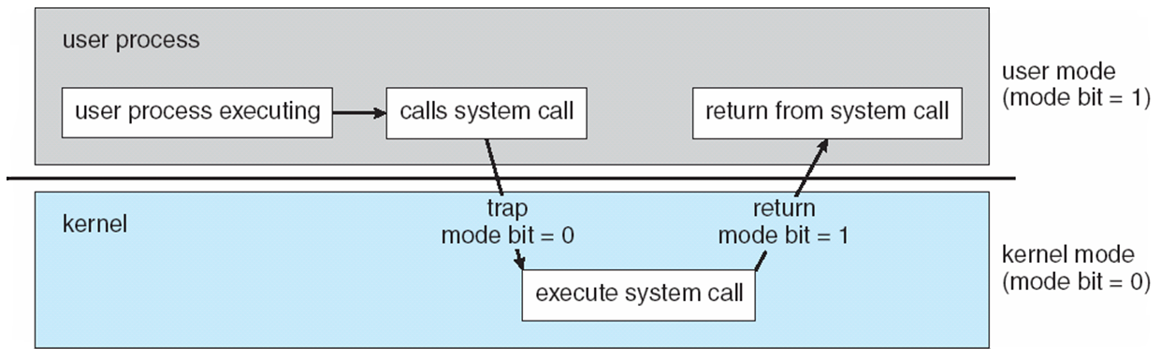
Dual mode processors

Slide 48
Time management
Timer to prevent infinite loop / process hogging resources (Watchdog timer)
Timer is set to interrupt the computer after some time period
Keep a counter that is decremented by the physical clock.
Operating system set the counter (privileged instruction)
When counter zero generate an interrupt
Set up before scheduling process to regain control or terminate program that exceeds allotted time

Slide 49
Process management
A process is a program in execution. It is a unit of work within the system. Program is a passive entity, process is an active entity.
Process needs resources to accomplish its task
CPU, memory, I/O, files
Initialization data
Process termination requires reclaim of any reusable resources
Single-threaded process has one program counter specifying location of next instruction to execute
Process executes instructions sequentially, one at a time, until completion
Multi-threaded process has one program counter per thread
Typically system has many processes, some user, some operating system running concurrently on one or more CPUs
Concurrency by multiplexing the CPUs among the processes / threads

Slide 50
Process management activities
The operating system is responsible for the following activities in connection with process management:
Creating and deleting both user and system processes
Suspending and resuming processes
Providing mechanisms for process synchronization
Providing mechanisms for process communication
Providing mechanisms for deadlock handling

Slide 51
Memory management
To execute a program all (or part) of the instructions must be in memory
All (or part) of the data that is needed by the program must be in memory.
Memory management determines what is in memory and when
Optimizing CPU utilization and computer response to users
Memory management activities
Keeping track of which parts of memory are currently being used and by whom
Deciding which processes (or parts thereof) and data to move into and out of memory
Allocating and de-allocating memory space as needed

Slide 52
Storage management
OS provides uniform, logical view of information storage
Abstracts physical properties to logical storage unit - file
Each medium is controlled by device (i.e., disk drive, tape drive)
Varying properties include access speed, capacity, data-transfer rate, access method (sequential or random)
File-System management
Files usually organized into directories
Access control on most systems to determine who can access what
OS activities include
Creating and deleting files and directories
Primitives to manipulate files and directories
Mapping files onto secondary storage
Backup files onto stable (non-volatile) storage media

Slide 53
Mass-storage management
Usually disks used to store data that does not fit in main memory or data that must be kept for a “long” period of time
Entire speed of computer operation hinges on disk subsystem and its algorithms
OS activities
Free-space management
Storage allocation
Disk scheduling
Some storage need not be fast
Tertiary storage includes optical storage, magnetic tape
Still must be managed – by OS or applications
Varies between WORM (write-once, read-many-times) and RW (read-write)

Slide 54
I/O subsystem
One purpose of OS is to hide peculiarities of hardware devices from the user
I/O subsystem responsible for:
Memory management of I/O including
buffering (storing data temporarily while it is being transferred)
caching (storing parts of data in faster storage for performance)
spooling (the overlapping of output of one job with input of other jobs)
General device-driver interface
Drivers for specific hardware devices

Slide 55

Protection and Security

Slide 56
Protection and security
Protection – any mechanism for controlling access of processes or users to resources defined by the OS
Security – defense of the system against internal and external attacks
Huge range, including denial-of-service, worms, viruses, identity theft, theft of service
Systems generally first distinguish among users, to determine who can do what
User identities (user IDs, security IDs) include name and associated number, one per user
User ID then associated with all files, processes of that user to determine access control
Group identifier (group ID) allows set of users to be defined and controls managed, then also associated with each process, file
Privilege escalation allows user to change to effective ID with more rights

Slide 57
Kernel data structures
Many similar to standard programming data structures
Singly linked list
Doubly linked list
Circular linked list

Slide 58
Kernel data structures
Binary search tree left <= right
Search performance is O(n)
Balanced binary search tree is O(lg n)
Example
Linux CPU-scheduling algorithm

Slide 59
Kernel data structures
Hash function can create a hash map
Collision problem
Example: username, password
Bitmap – string of n binary digits representing the status of n items (0011010111001010)
Example: Disk block availability
Linux data structures defined in
include files <linux/list.h>, <linux/kfifo.h>, <linux/rbtree.h>

Slide 60
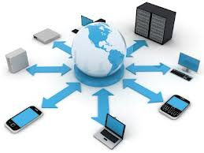
Computing Environment

Slide 61
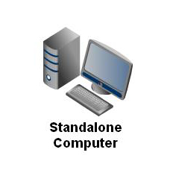
Computing environments (traditional)
Stand-alone general purpose machines
But blurred as most systems interconnect with others (i.e., the Internet)
Portals provide web access to internal systems
Network computers (thin clients) are like Web terminals
Mobile computers interconnect via wireless networks
Networking becoming ubiquitous (IoT)– even home systems use firewalls to protect home computers from Internet attacks

Slide 62
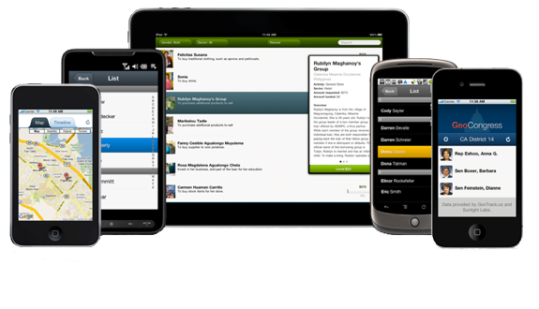
Computing environments (Mobile)
Handheld smartphones, tablets, etc
What is the functional difference between them and a “traditional” laptop?
Extra feature – more OS features (GPS, gyroscope)
Allows new types of apps like augmented reality
Use IEEE 802.11 wireless, or cellular data networks for connectivity
Leaders are Apple iOS and Google Android

Slide 63
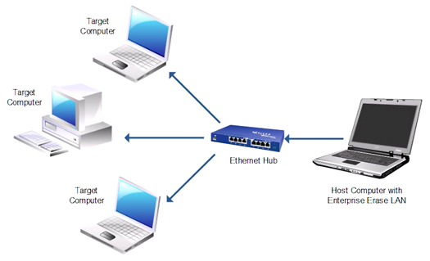
Computing environments (distributed)
Distributed computing
Collection of separate, possibly heterogeneous, systems networked together
Network is a communications path, TCP/IP most common
Local Area Network (LAN)
Wide Area Network (WAN)
Metropolitan Area Network (MAN)
Personal Area Network (PAN)
Network Operating System
Provides features between systems across network
Communication scheme allows systems to exchange
messages
Illusion of a single system

Slide 64
Computing environments (Client-Server)
Client-Server Computing
Dumb terminals supplanted by smart PCs
Many systems now servers, responding to requests generated by clients
Compute-server system provides an interface to client to request services (i.e., database)
File-server system provides interface for clients to store and retrieve files

Slide 65
Computing environments (Peer-to-Peer)
Another model of distributed system
P2P does not distinguish clients and servers
No bottleneck server!
Instead all nodes are considered peers
May each act as client, server or both
Node must join P2P network
Registers its service with central lookup service on network, or
Broadcast request for service and respond to requests for service via discovery protocol
Examples include Napster and Gnutella, Voice over IP (VoIP) such as Skype

Slide 66
Computing environments (Virtualization)
Allows operating systems to run applications within other OSes
Vast and growing industry
Emulation used when source CPU type different from target type (i.e. PowerPC to Intel x86)
Generally slowest method
When computer language not compiled to native code – Interpretation
Virtualization – OS natively compiled for CPU, running guest OSes also natively compiled
Consider VMware running WinXP guests, each running applications, all on native WinXP host OS
VMM (virtual machine manager) provides virtualization services

Slide 67
Computing environments (Virtualization)
Virtualization vs. Emulation (both are SW)
OS to OS vs. CPU to CPU
Use cases involve laptops and desktops running multiple OSes for exploration or compatibility
Apple laptop running Mac OS X host, Windows as a guest
Developing apps for multiple OSes without having multiple systems
QA testing applications without having multiple systems
Executing and managing compute environments within data centers
VMM can run natively, in which case they are also the host
There is no general purpose host then (VMware, ESX and Citrix XenServer)

Slide 68
Computing environments (Virtualization)

Slide 69
Computing environments (Cloud Computing)
Delivers computing, storage, even apps as a service across a network
Logical extension of virtualization because it uses virtualization as the base for it functionality.
Amazon EC2 has thousands of servers, millions of virtual machines, petabytes of storage available across the Internet, pay based on usage
Many types
Public cloud – available via Internet to anyone willing to pay
Private cloud – run by a company for the company’s own use
Hybrid cloud – includes both public and private cloud components
Software as a Service (SaaS) – one or more applications available via the Internet (i.e., word processor)
Platform as a Service (PaaS) – software stack ready for application use via the Internet (i.e., a database server)
Infrastructure as a Service (IaaS) – servers or storage available over Internet (i.e., storage available for backup use)

Slide 70
Computing environments (Cloud Computing)
Cloud computing environments composed of traditional OSes, plus VMMs, plus cloud management tools
Internet connectivity requires security like firewalls
Load balancers spread traffic across multiple applications

Slide 71
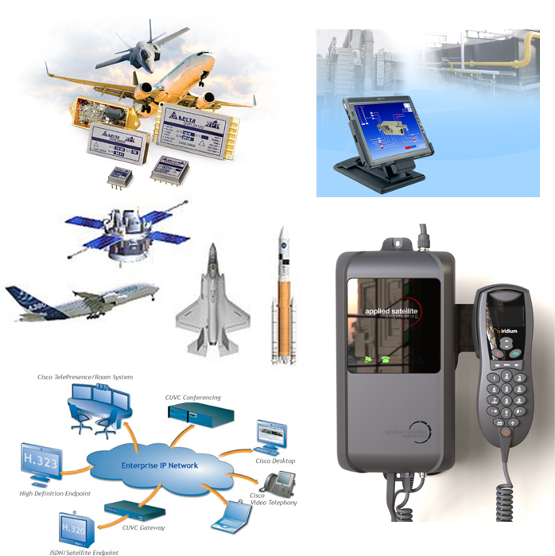
Computing environments (Real-Time Embedded Systems)
Real-time embedded systems most prevalent form of computers
Vary considerable, special purpose, limited purpose OS, real-time OS
Use expanding
Many other special computing environments as well
Some have OSes, some perform tasks without an OS
Real-time OS has well-defined fixed time constraints
Processing must be done within constraint (soft, firm, hard)
Correct operation only if constraints met

Slide 72
Open-source operating systems
Operating systems made available in source-code format rather than just binary closed-source
Counter to the copy protection and Digital Rights Management (DRM) movement
Started by Free Software Foundation (FSF), which has “copyleft” GNU Public License (GPL)
Examples include GNU/Linux and BSD UNIX (including core of Mac OS X), and many more
Can use VMM like VMware Player (Free on Windows), Virtualbox (open source and free on many platforms - http://www.virtualbox.com)
Use to run guest operating systems for exploration
All book materials are available at: www.os-book.com

Slide 73

Questions?

